Slide 1

HR ANALYTICS USING IBM COGNOS
TEAM MEMBERS:
Bandaru VAISHNAVI
B.SAI SACHIN
B.MADHAVI
CH.ABHISHEK
CH.HEMANTH KUMAR

Slide 2
INTRODUCTION
Of all the departments in an organization, the Human Resource (HR) department may have the least popular reputation.
This has two reasons. First of all, they are like a doctor: you’d rather never need one. When the HR manager calls you and asks to come by their office, it’s likely that there’s something bad about to happen. You may get reprimanded, put on notice, or even fired. If it was good news, like getting a promotion, your manager would tell you. Not HR.
Second, HR is regarded as soft. Fluffy-duddy. Old-fashioned. A lot of the work in HR is based on ‘gut feeling’. We’re doing things a certain way because we’ve always done it that way. HR doesn’t have a reputation of bringing in the big bucks or playing a numbers game like sales. HR also struggles to quantify and measure its success, as marketing and finance do.

Slide 3

What is hr analytics ?
HR analytics is the process of collecting and analyzing Human Resource (HR) data in order to improve an organization’s workforce performance. The process can also be referred to as talent analytics, people analytics, or even workforce analytics.
This method of data analysis takes data that is routinely collected by HR and correlates it to HR and organizational objectives. Doing so provides measured evidence of how HR initiatives are contributing to the organization’s goals and strategies.

Slide 4

HR teams use HR analytics for three important reasons.
Understand their workforce.
Efficiently deploy resources.
Plan for the future.

Slide 5

Benefits of hr analytics
Improved Hiring Decisions
Reduced Talent Scarcity
Improved Hiring Process
Good Training
Better Employee Insights
Reduced Attrition Rate
Improved Candidate Experience
More Productive Workforce

Slide 6

Problem statements
STATEMENTS:
Know fundamental concepts and can work on IBM Cognos Analytics.
Gain a broad understanding of plotting different graphs.
Able to create meaningful dashboards

Slide 7

Problem solutions
SOLUTION:
To accomplish this, we have to complete all the activities and tasks listed below
IBM Cloud Account
Log in to Cognos Analytics
Working with the Dataset
Data visualization charts
Dashboard Creation
Export the Analytics

Slide 8
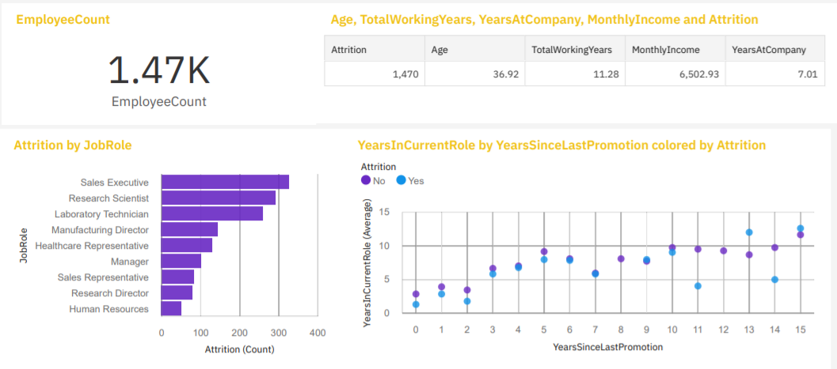
Visualization charts

Slide 9
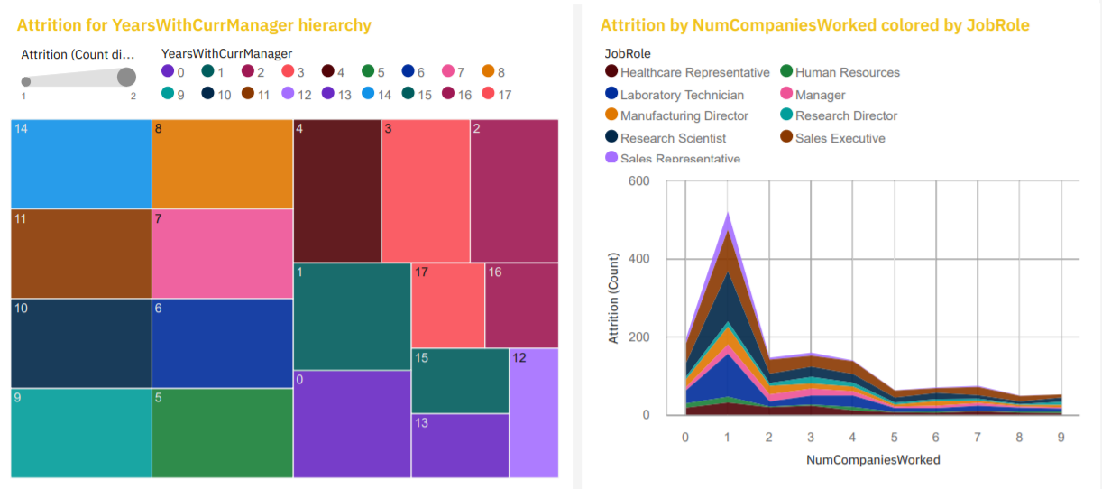

Slide 10


